Slide 1
Lecture 7: Externalities in Value Chain Agriculture

Slide 2
EXTERNALITIES

Slide 3
Understanding externalities is crucial for value chain agriculture students as they play a significant role in market efficiency and resource allocation.

Slide 4
Externalities
Externalities refer to the unintended and uncompensated side effects of economic activities (production and consumption) on third parties/bystanders who are not involved in the transactions.
These effects can either be positive or negative and occur outside the market
Externality refers to the uncompensated impact of one person’s actions on the well-being of a bystander

Slide 5
Classification of Externalities
Externalities can be classified into two main types:
Positive Externality:
Occurs when an activity creates benefits for third parties who are not directly involved in the activity.
E.g. the use of organic farming practices can improve soil health and benefit neighboring farms.
Negative Externality:
Occurs when an activity imposes costs on third parties who are not directly involved in the activity.
E.g. air pollution from agricultural machinery can harm the health of nearby residents.

Slide 6
Occurrence of Externalities in Agricultural Activities
In agriculture, externalities are prevalent due to the interconnectedness of various production and consumption activities.
Externalities in agriculture include:
Positive Externality: When a beekeeper sets up beehives for honey production, it leads to increased pollination of nearby crops, benefiting neighboring farmers.
Negative Externality: Pesticide use by one farmer may lead to chemical runoff into nearby water sources, affecting the quality of water for other farmers downstream.

Slide 7
Effects of Externalities on Market Efficiency
Externalities can disrupt the efficiency of the market as prices and quantities do not fully account for the external costs or benefits. This leads to:
Underproduction of Positive Externalities: If positive externalities exist, the market may produce less than the socially optimal level of output.
Overproduction of Negative Externalities: If negative externalities exist, the market may produce more than the socially optimal level of output.

Slide 8
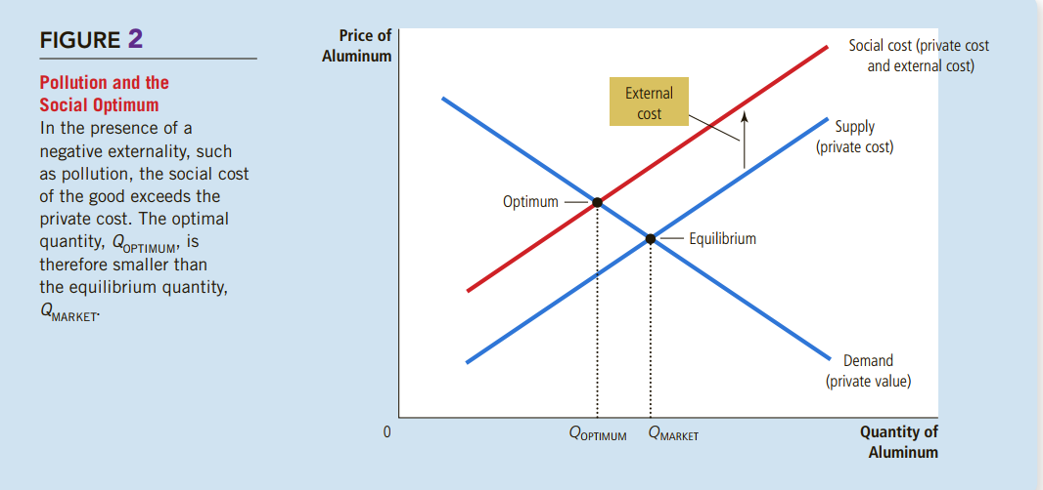

Slide 9
To summarize:
Negative externalities lead markets to produce a larger quantity than is socially desirable.
Positive externalities lead markets to produce a smaller quantity than is socially desirable.
To remedy the problem, the government can internalize the externality by taxing goods that have negative externalities and subsidizing goods that have positive externalities

Slide 10
Resource Allocation and Externalities
Externalities also affect the allocation of resources in value chain agriculture.
When externalities are present, the private costs and benefits of production or consumption do not reflect the true social costs and benefits.

Slide 11
Policy Options to Internalize Externalities
To address externalities and promote market efficiency, policymakers have several options:
Taxes and Subsidies:
Implementing taxes on activities with negative externalities or providing subsidies for activities with positive externalities can internalize the external effects.
Regulations:
Setting environmental regulations or standards can control the negative externalities, such as emission limits for agricultural machinery.

Slide 12
Case Studies and Exercises
Provide real-life case studies or exercises on externalities in value chain agriculture. Students can analyze the scenarios and identify the type of externality, its impact on market efficiency, and propose policy solutions.
Externalities are an essential aspect of value chain agriculture, influencing market efficiency and resource allocation. Understanding the types and impacts of externalities allows students to develop informed solutions and policies that promote sustainable and efficient agricultural practices

